Slide 1
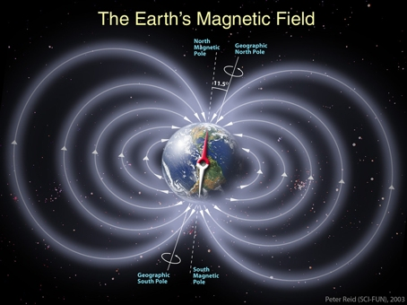
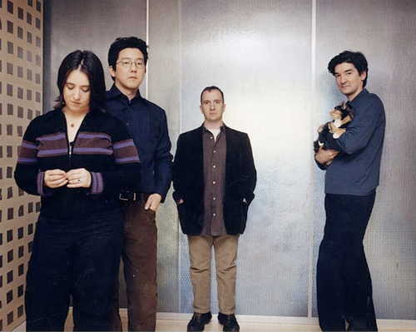
Section 9: Magnetic Field and Magnetic Forces

Slide 2
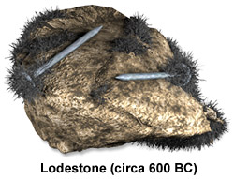
Magnetism: Some History

Slide 3


Magnetic Poles
Like poles of magnetic fields repel each other.
Unlike poles of magnetic fields attract each other.

Slide 4
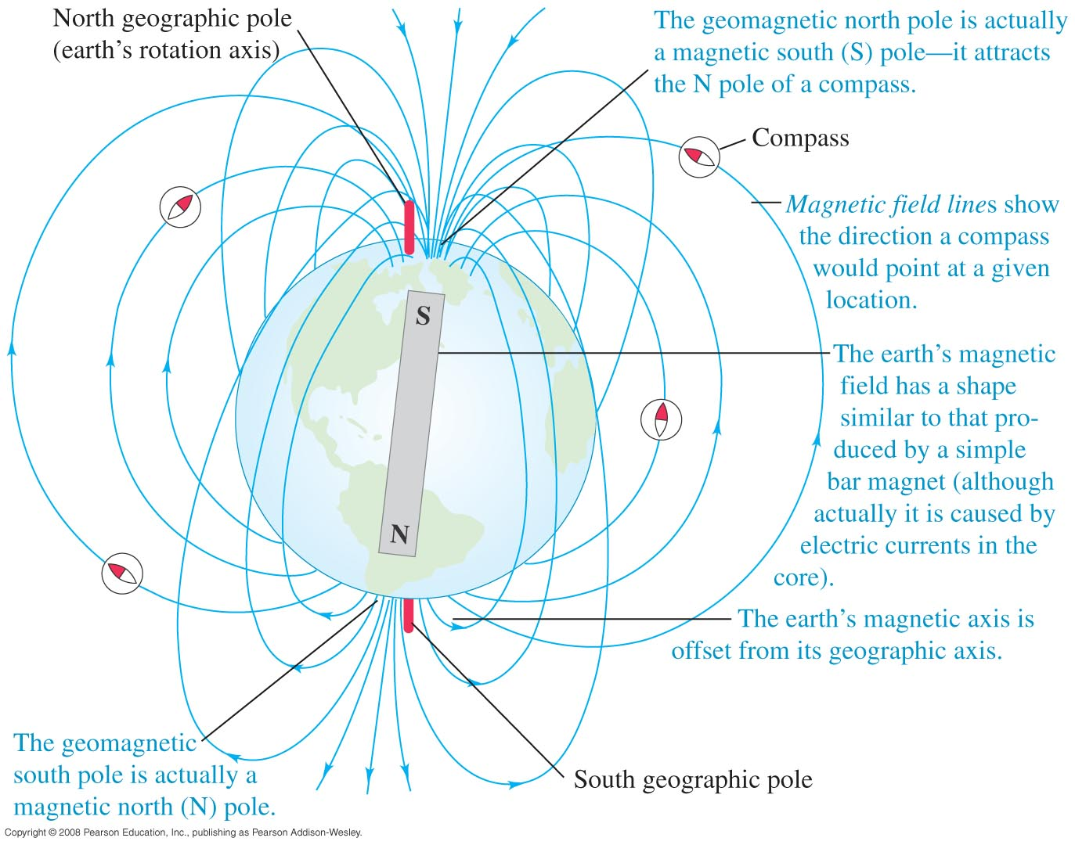
The Earth as a Magnet

Slide 5
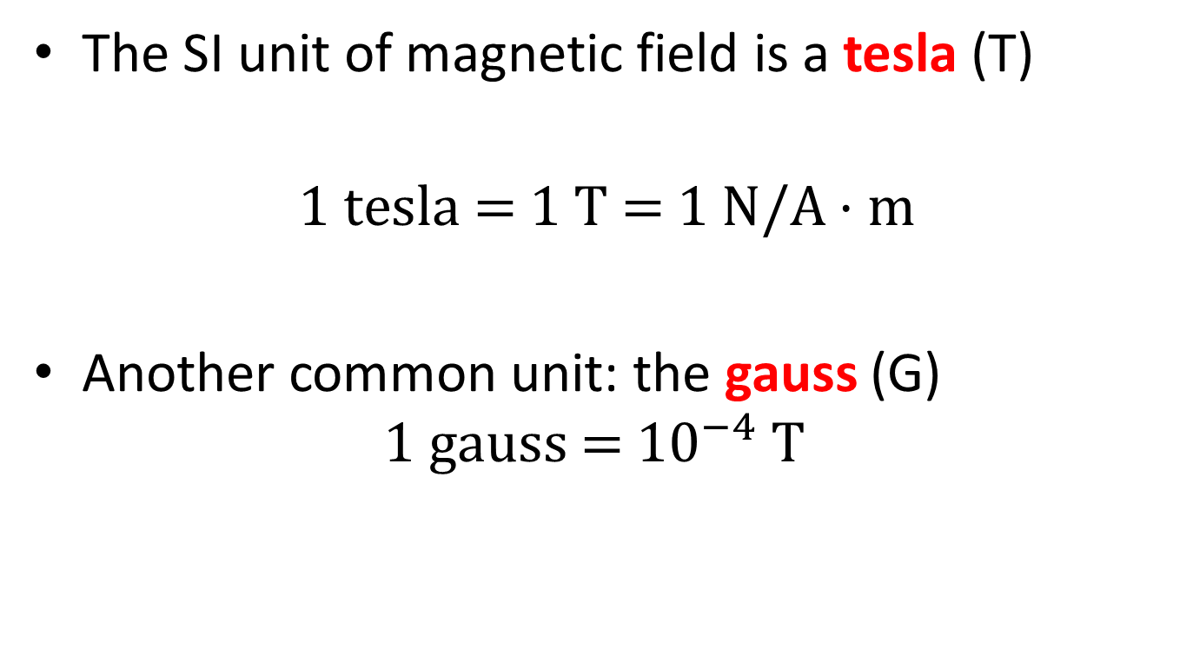
Magnetic Field Units
The SI unit of magnetic field is a tesla (T)
$$1 \text{tesla}\text{ = 1 }\text{T}\text{ = 1 }\text{N}\text{/}\text{A}·\text{m}$$
Another common unit: the gauss (G)
$$1 \text{gauss}\text{ = }{\text{10}}^{−4} \text{T}$$

Slide 6
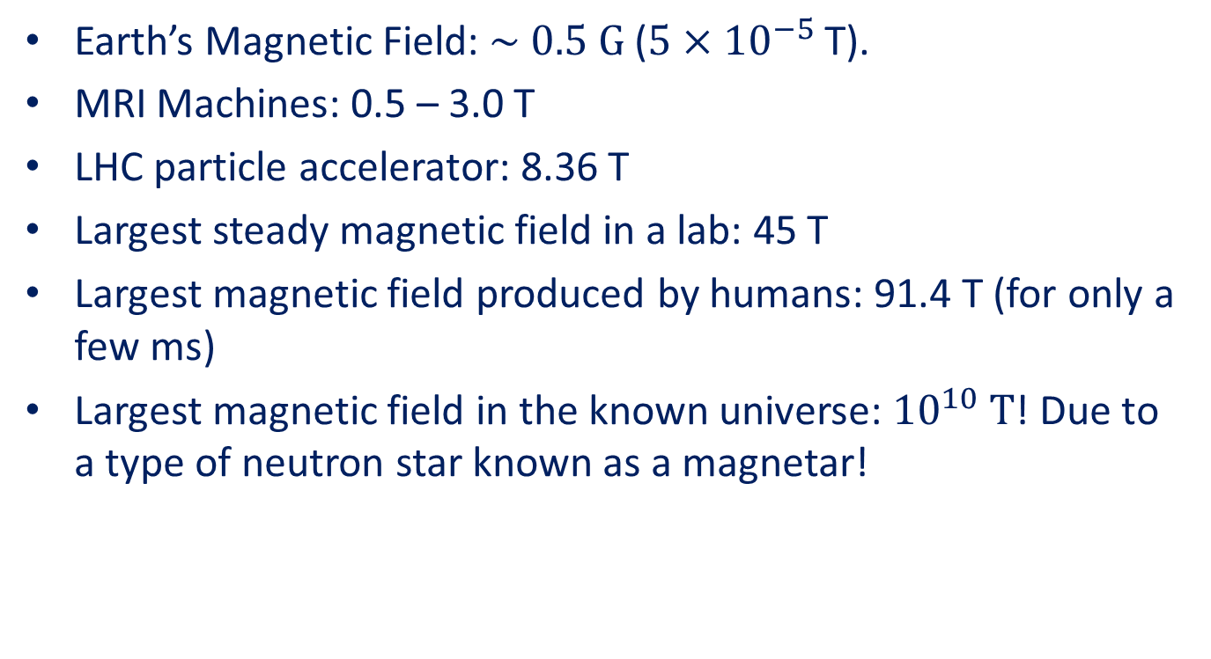
Magnetic Field Examples
Earth’s Magnetic Field: $\sim 0.5 \text{G}$ ($5×{10}^{−5}$ T).
MRI Machines: 0.5 – 3.0 T
LHC particle accelerator: 8.36 T
Largest steady magnetic field in a lab: 45 T
Largest magnetic field produced by humans: 91.4 T (for only a few ms)
Largest magnetic field in the known universe: ${10}^{10} \text{T}$! Due to a type of neutron star known as a magnetar!

Slide 7
Demo: Bar magnets (& Proj)
Show Field Lines with compasses
Demo: Horseshoe Magnet (& Proj)
Show Field Lines with compasses
Pass around Magnets

Slide 8
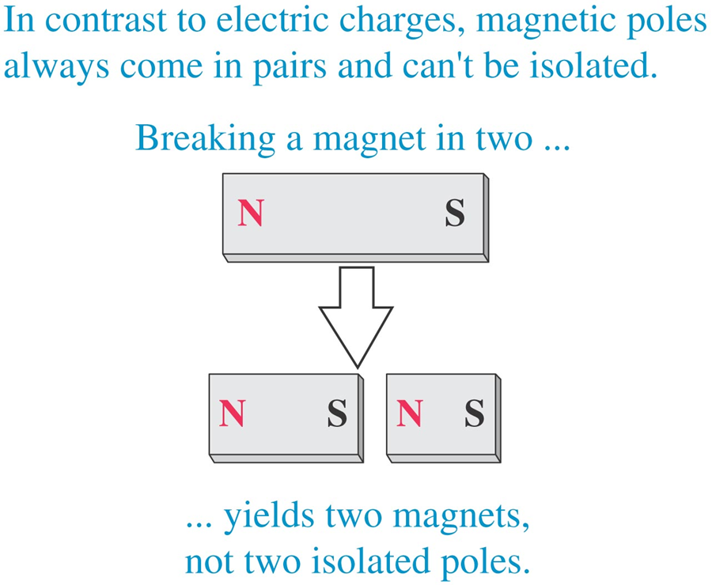
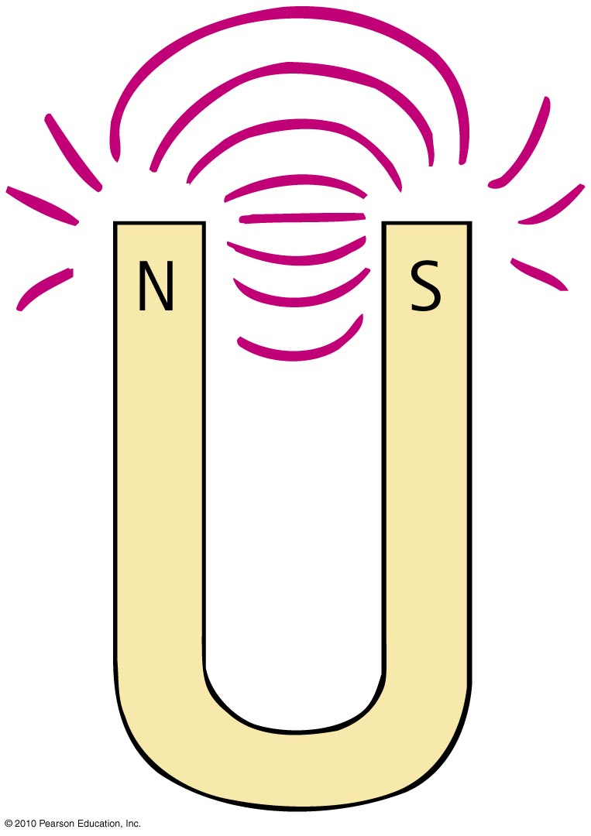
Magnetic Fields: Poles
Magnetic poles
Can’t have one pole without the other
No single pole known to exist!!

Slide 9
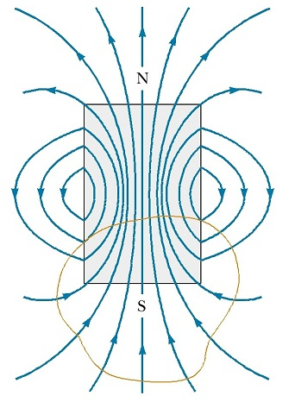
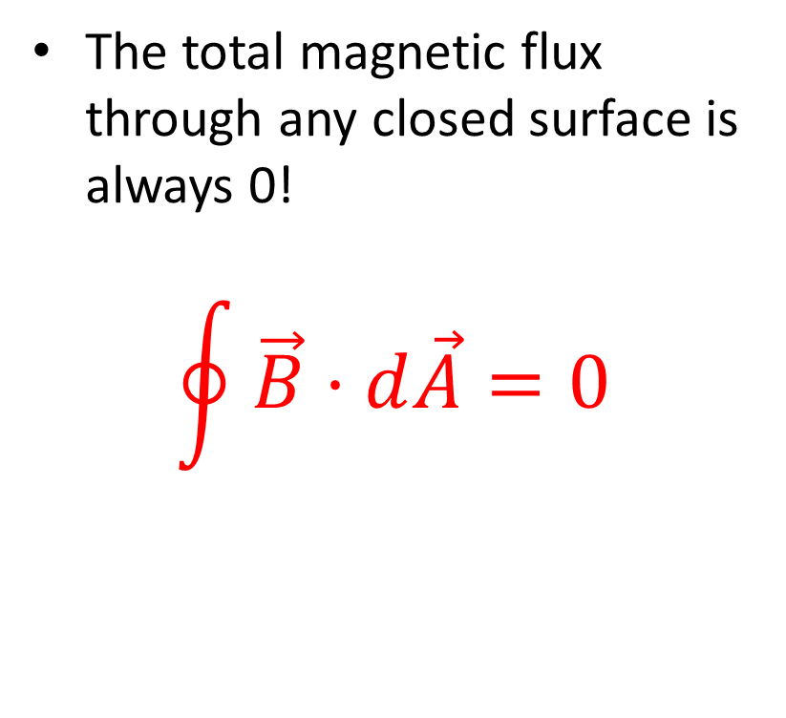
Gauss’s Law for Magnetism
The total magnetic flux through any closed surface is always 0!
$$\oint{\vec{B}·d\vec{A}}=0$$

Slide 10
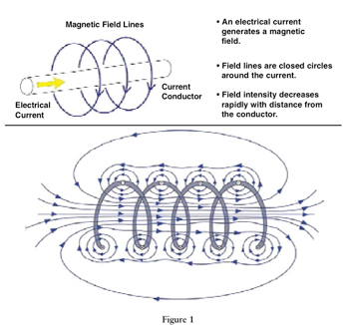
The Origin of Magnetic Fields
Magnetic fields are created by… moving electric charges!!

Slide 11
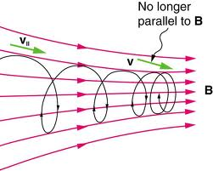
The Magnetic Force
The magnetic force is felt by… moving electric charges!!

Slide 12
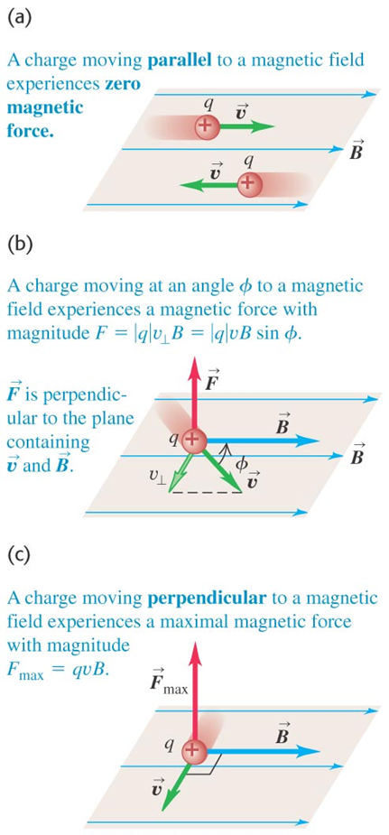

The Magnetic Force
$${\vec{F}}_{B}=q\vec{v}×\vec{B}$$

Slide 13

Work and the Magnetic Force
Magnetic fields cannot do work!!!

Slide 14
Magnetic Force on a CRT Tube
Demo

Slide 15
Magnetic Forces: Activity

Slide 16
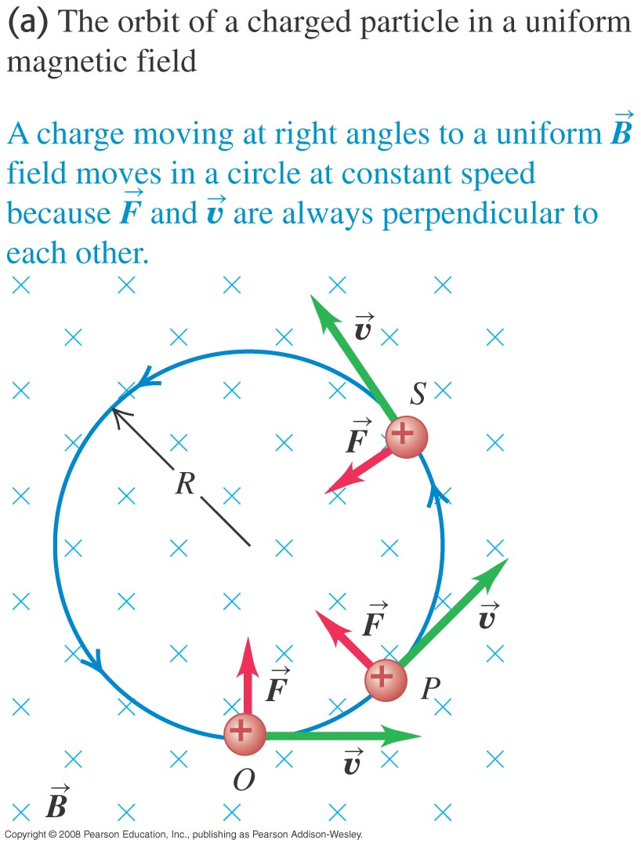
Motion in a Magnetic Field Velocity Perpendicular to Field

Slide 17
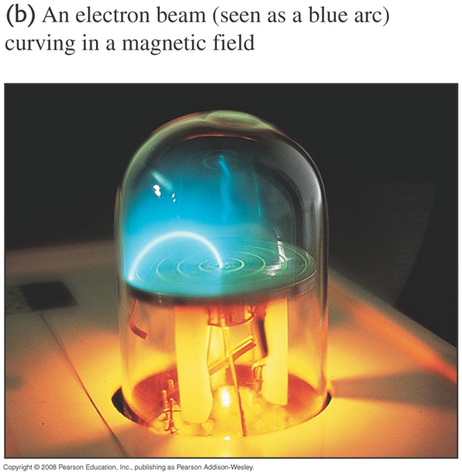
Electron Beam Motion Video

Slide 18
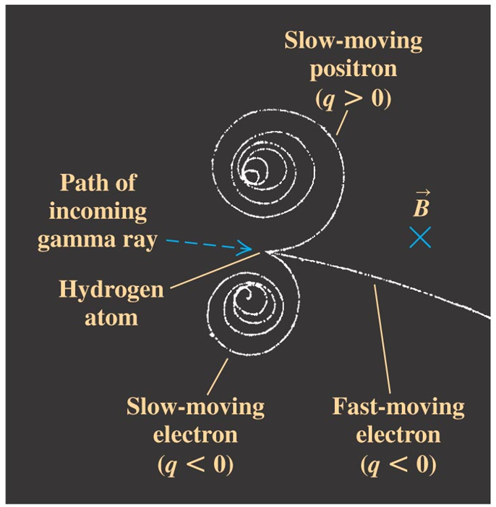
Bubble Chamber Tracks: Particle Detection!

Slide 19
Example: Motion in a Uniform Magnetic Field

Slide 20
Activity: Mass Spectrometer Part I

Slide 21
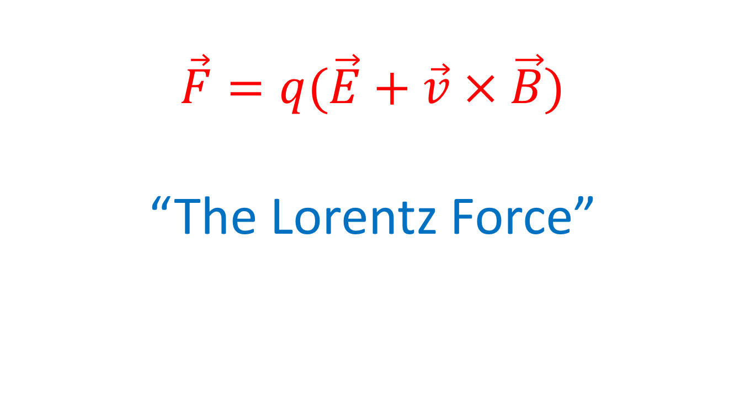
Electric and Magnetic Forces Combined!
$$\vec{F}=q(\vec{E}+\vec{v}×\vec{B})$$
“The Lorentz Force”

Slide 22
Activity: Mass Spectrometer Part II

Slide 23
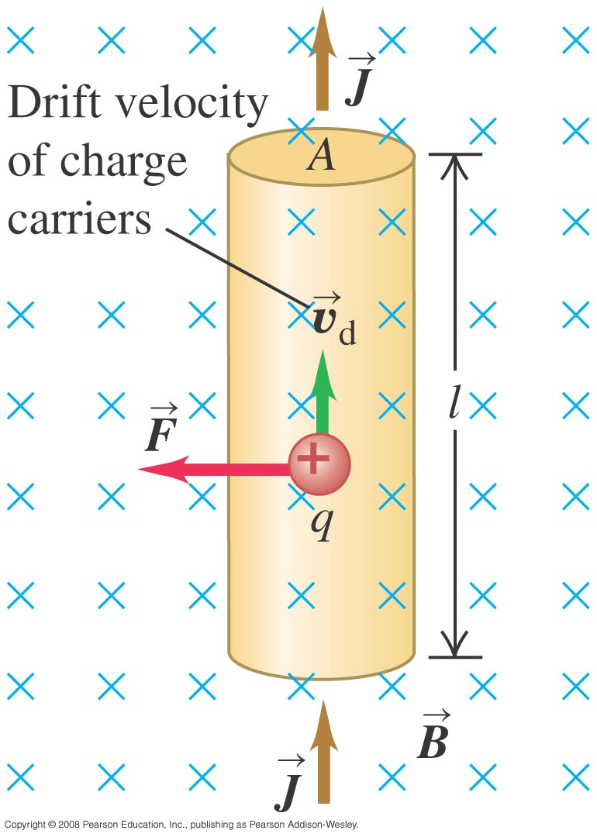
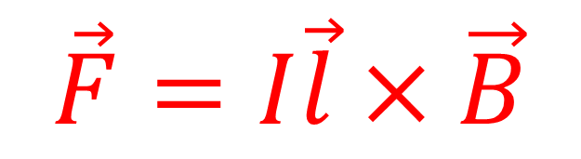
Force on Current-Carrying Wire
$$\vec{F}=I\vec{l}×\vec{B}$$
Demo: Current-Carrying Wire and Magnetic Field

Slide 24
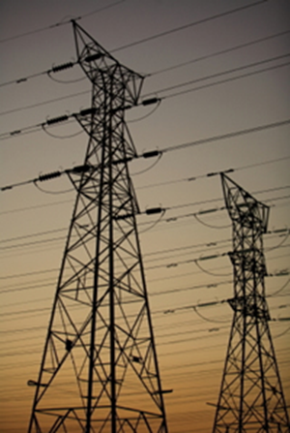
Activity: Power Lines

Slide 25
Example Problem: Power Lines

Slide 26
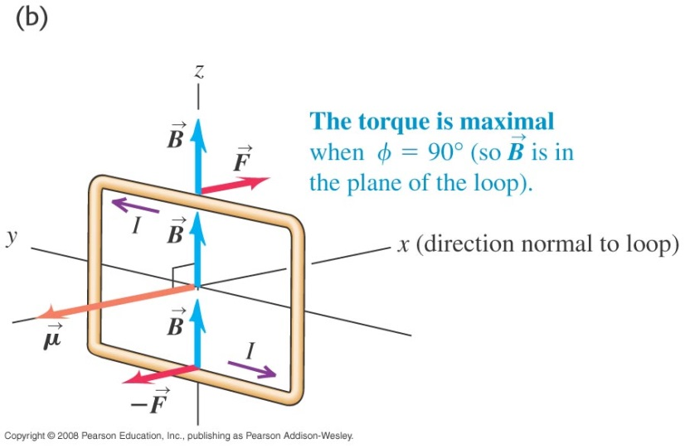
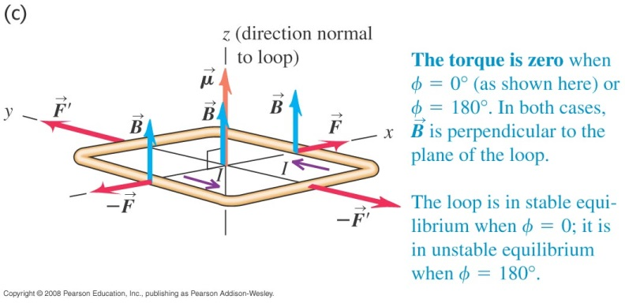
Current Loops and Torque in a $\vec{B}$ Field

Slide 27
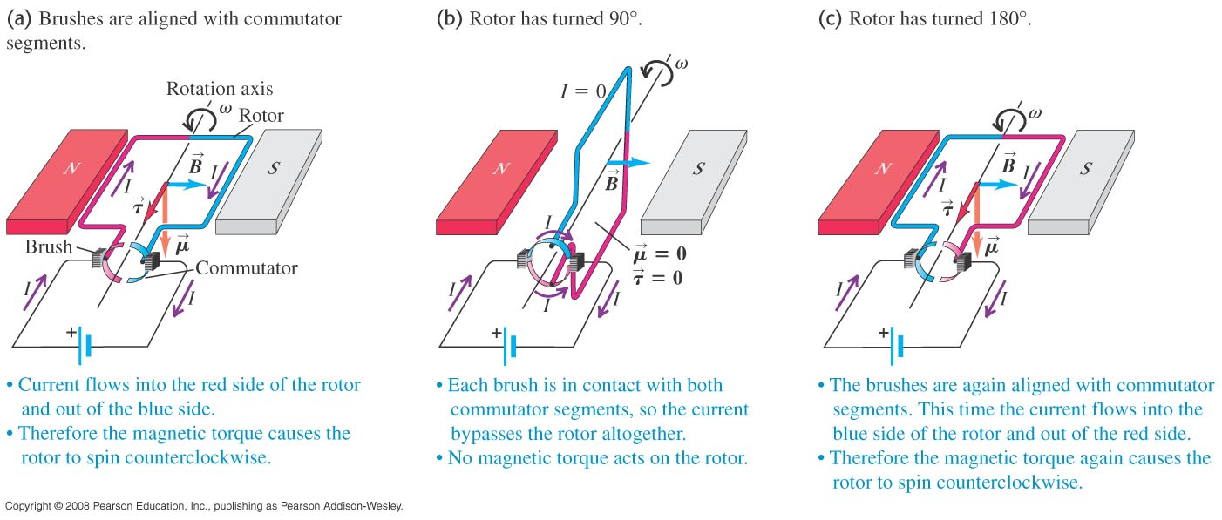
The DC Motor!
Demo: A motor!!!

Slide 28
Summary QUESTION
Can an electron at rest in a magnetic field
be set into motion by the magnetic field?
(b) Can an electron at rest in an electric
field be set into motion by the electric field?
1) (a) yes (b) yes
2) (a) yes (b) no
3) (a) no (b) no
4) (a) no (b) yes
Notes:
No. Particle needs a velocity first.
Yes, that’s what the electric field does to particles.

